Slide 1
Power Electronics
Dr. HE Yongbo
Aeronautical Automation College
Civil Aviation University of China
Oct. 2010

Slide 2
Content
Introduction
Power Electronic Devices
AC to DC Converters
DC to DC Converters (Choppers)
AC to AC Converters
DC to AC Converters
PWM Techniques

Slide 3
Introduction
Definition of Power Electronics
is the electronics applied to conversion and control of electric power.
Power
Input
Electric Power
Converter
Power
Output
Control input
Feed forward
Feed back
Controller
Reference

Slide 4
Classification of power converters
Power Power output input | DC | AC
DC | DC to DC Converter (Chopper) | DC to AC converter (Inverter)
AC | AC to DC converter (Rectifier) | AC to AC converter Fixed frequency : AC controller Variable frequency: frequency converter

Slide 5
William E. Newell’s description
Power electronics is the interface between electronics and power.
Electronics
Power
Devices, Circuits
Static & rotating
power equipment
Power
Electronics
Continuous, discrete
Control

Slide 6
A simple example
I 10A
+
R V
5Ω 50V
-
DC-DC
Converter
+
-
Vg
100V
Input source:100V
Output load:50V, 10A, 500W
How can this converter be realized?

Slide 7
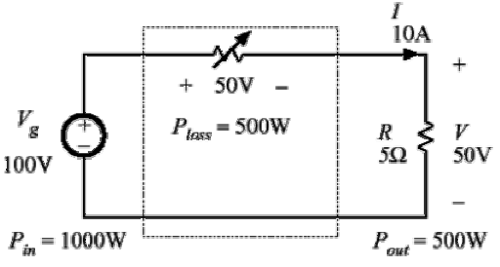
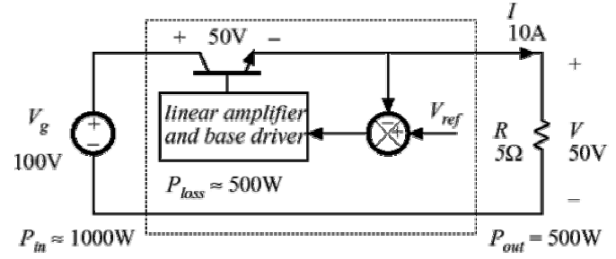
Dissipative realization
Resistive voltage divider
Series pass regulator
  transistor operates in active region

Slide 8
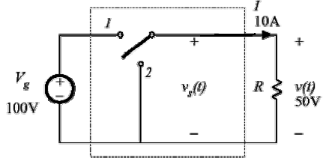
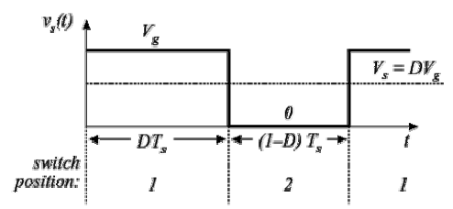
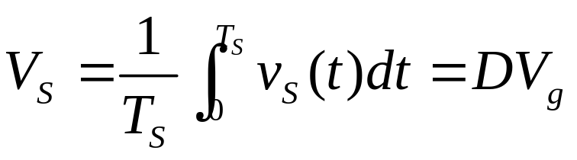
Use of a SPDT switch
The switch changes the dc voltage level
D = switch duty cycle
0≤ D ≤1
Ts = switching period
fs = switching frequency
= 1/ Ts
DC component of Vs(t) = average value

Slide 9
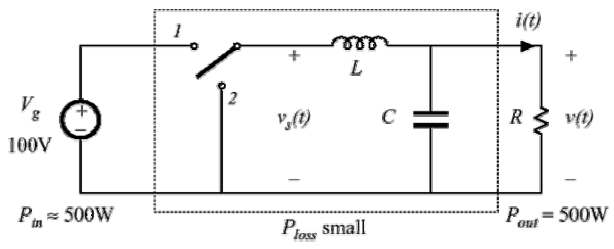
Addition of low pass filter
Addition of (ideally lossless) L-C low-pass filter, for removal of switching harmonics:
This circuit is known as the “buck converter”

Slide 10
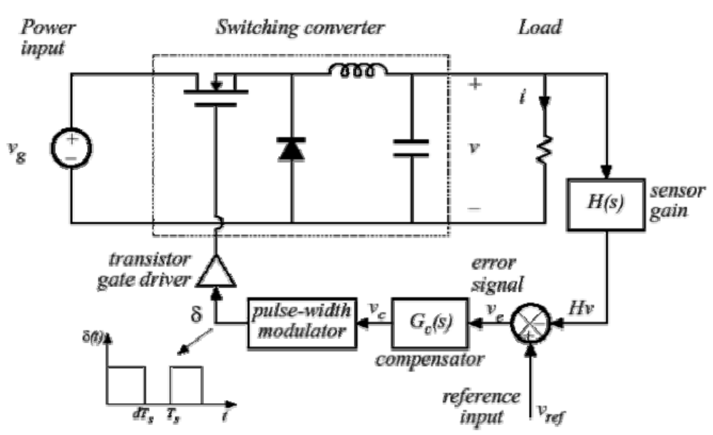
Addition of control system for regulation of output voltage

Slide 11
Major issues in power electronics
How to meet the requirement of the load or gain better control of the load
How to improve the efficiency
  for reliable operation of power semiconductor devices
  for energy saving
How to realize power conversion with less volume, less weight, and less cost
How to reduce negative influence to other equipment in the electric power system and to the electromagnetic environment

Slide 12
2. Power Electronic Devices
Outline
Uncontrolled device — power diode
Half-controlled device — thyristor
Typical fully-controlled devices
Drive circuit for power electronic devices
Protection of power electronic devices

Slide 13
Features of power electronic devices
The electric power that power electronic device deals with is usually much larger than that the information electronic device does.
Usually working in switching states to reduce power losses
  On-state → Voltage across the device is 0, v=0, p=vi=0
  Off-state → Current through the device is 0, i=0, p=vi=0
Need to be controlled by information electronic circuits.
Dissipated power loss usually larger than information electronic devices — special packaging and heat sink are necessary.

Slide 14
Terminals of a power electronic device
A power electronic device usually has a third terminal — control terminal to control the
states of the device.
A power electronic device must have at least two terminals to allow power circuit current flow through.
C
G
E
Drive Circuit
Control signal from drive circuit must be connected between the control terminal and a fixed power circuit terminal (therefore called common terminal ).

Slide 15
A classification of power electronic devices
Uncontrolled device: diode
  has only two terminals and can not be controlled by control signal. The on and off states of the device are determined by the power circuit.
Half-controlled device: thyristor
  is turned-on by a control signal and turned-off by the power circuit
Fully-controlled device: Power MOSFET, IGBT,GTO
  The on and off states of the device are controlled by control signals.

Slide 16
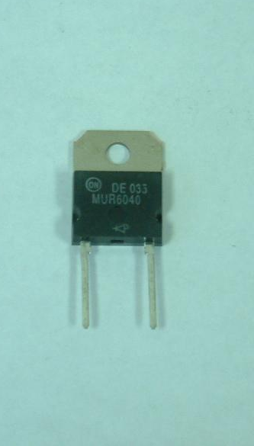
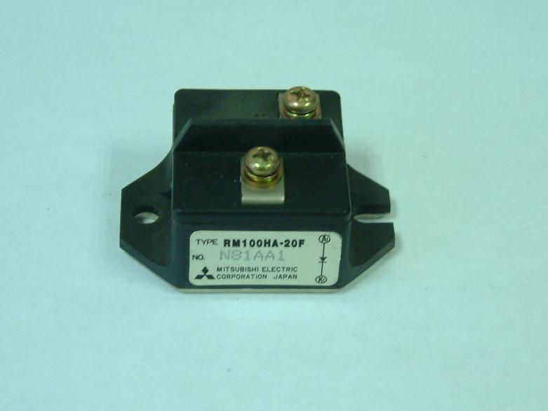
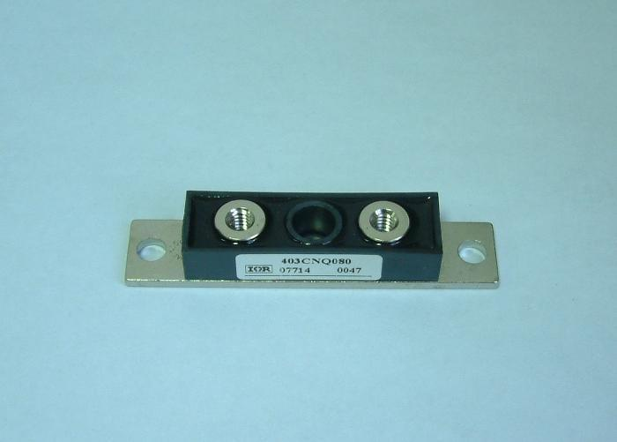
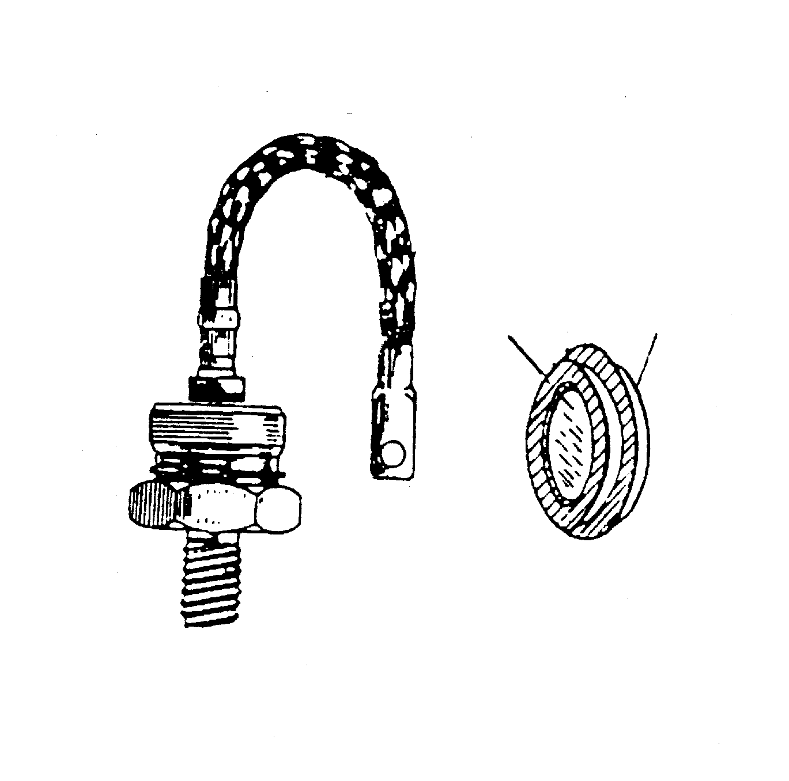
Uncontrolled device Power diode
I
I
F
A
K
A
P
N
K
I
J
K
O
U
U
U
b)
TO
F
A
K
A
a)
c)

Slide 17
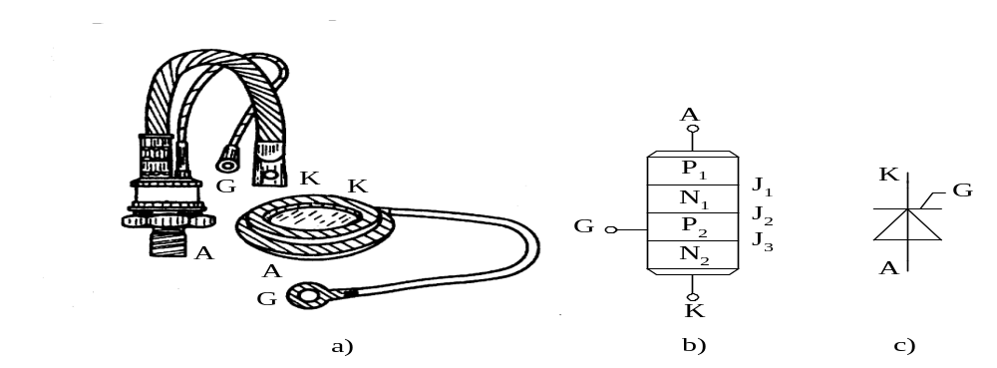
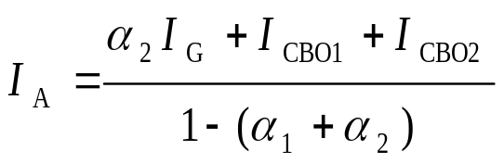
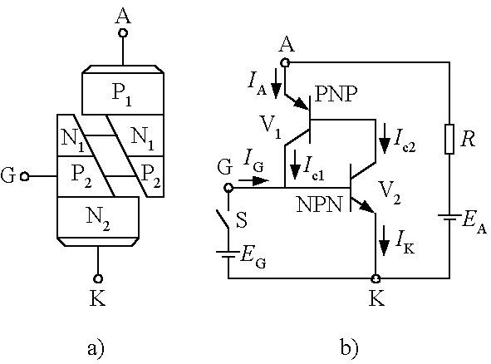




Half-controlled device—Thyristor
Silicon Controlled Rectifier——SCR
（1-5）
（1-1）
（1-2）
（1-3）
（1-4）

Slide 18
Typical fully-controlled devices
Types:
  Gate-turn-off thyristor —GTO
  Giant transistor —GTR
  Power metal-oxide-semiconductor field effect transistor — Power MOSFET
  Insulated-gate bipolar transistor —IGBT

Slide 19
3. AC to DC Converters (Rectifiers)
Outline
  Single-phase controlled rectifier
  Three-phase controlled rectifier
  Capacitor-filtered uncontrolled rectifier
  Thyristor-DC motor system

Slide 20
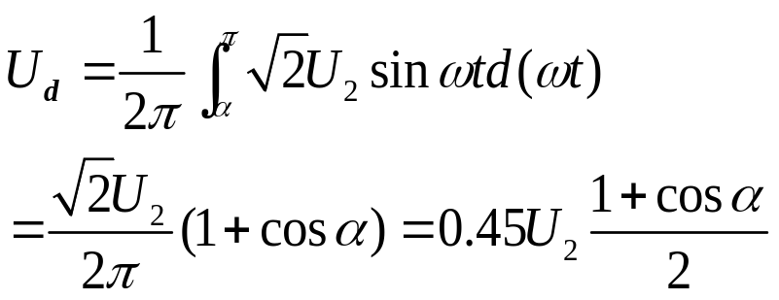
Single-phase half-wave controlled rectifier
Resistive load
Triggering delay angle
delay angle
firing angle
T
VT
u
i
d
a)
u
u
VT
u
R
1
2
d
u
2
b)
0
ω
t
π
π
ω
t
1
2
u
g
c)
ω
0
t
u
d
d)
0
ω
α
θ
t
u
VT
e)
0
ω
t

Slide 21
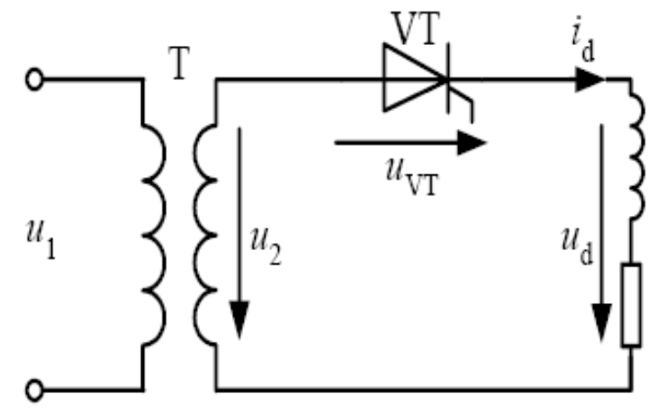
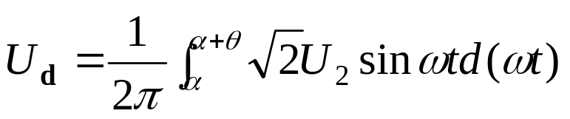
Single-phase half-wave controlled rectifier
Inductive (resistor-inductor) load
u
2
b)
0
ω
t
π
2
π
ω
t
u
1
g
c)
0
ω
t
u
d
d)
+
+
0
α
ω
t
i
d
e)
0
θ
ω
t
u
VT
f)
0
ω
t

Slide 22
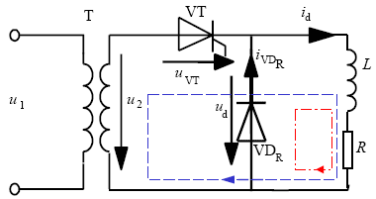
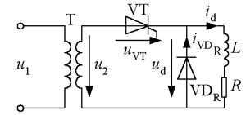
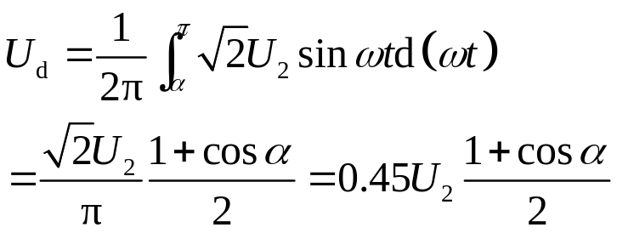
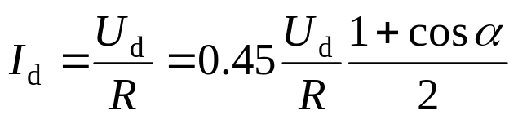
Inductive load with freewheeling diode
a)
u
2
b)
O
ω
t
1
ω
t
u
d
c)
ω
O
t
i
d
d)
I
d
i
O
ω
t
VT
I
d
e)
π
+
α
ω
i
O
π
-
α
t
VD
R
f)
ω
O
t
u
VT
g)
O
ω
t

Slide 23
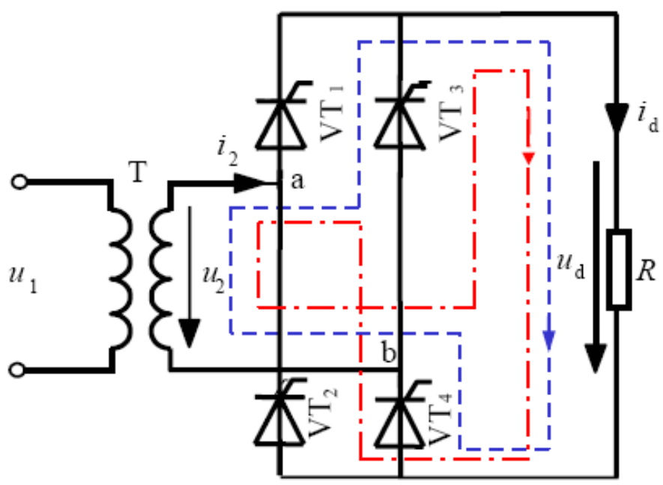
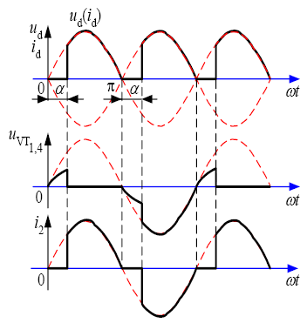
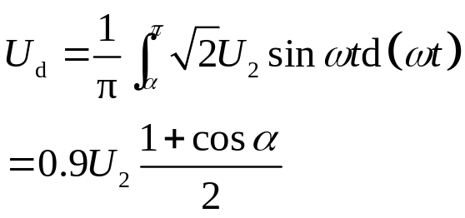
Single Phase Bridge Controlled Rectifier

Slide 24
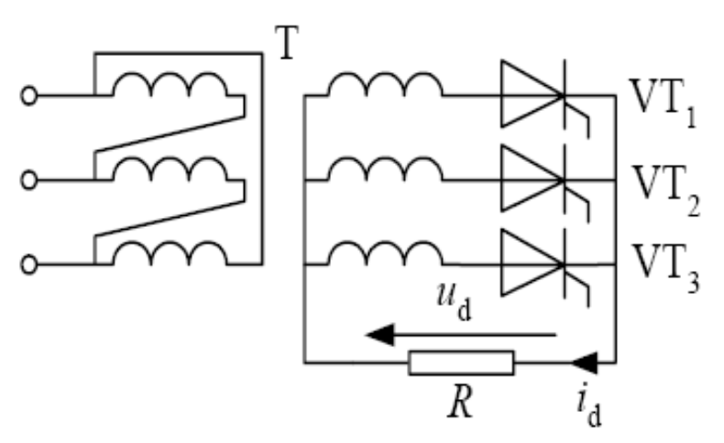
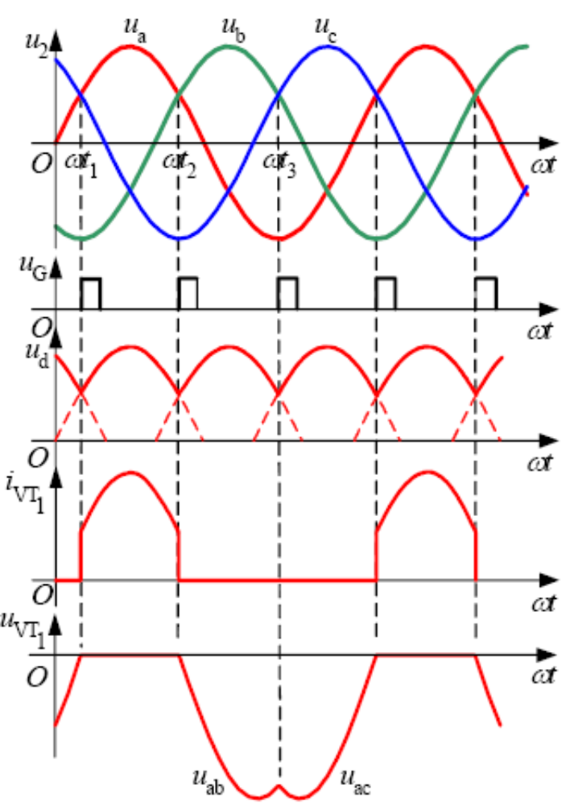
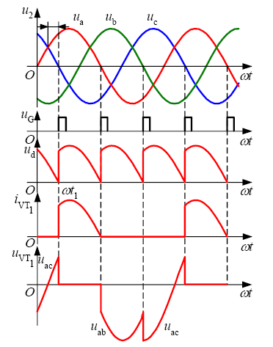
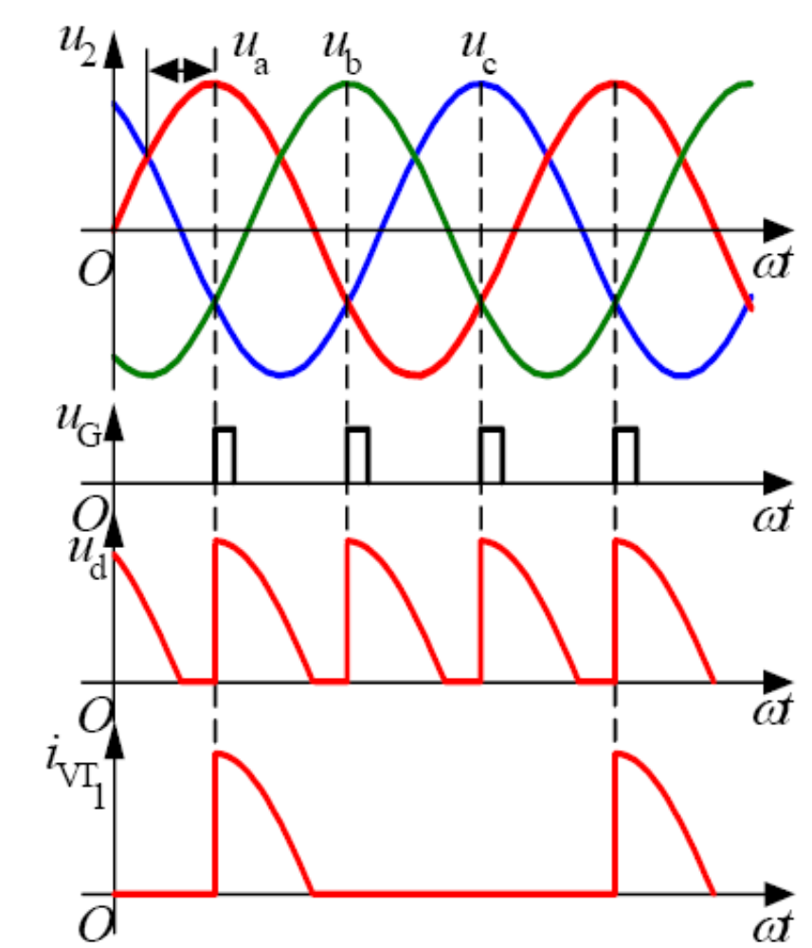
Three-phase half-wave controlled rectifier
Resistive load
α = 0º, 30º, 60º
Common-cathode connection
Natural commutation point

Slide 25
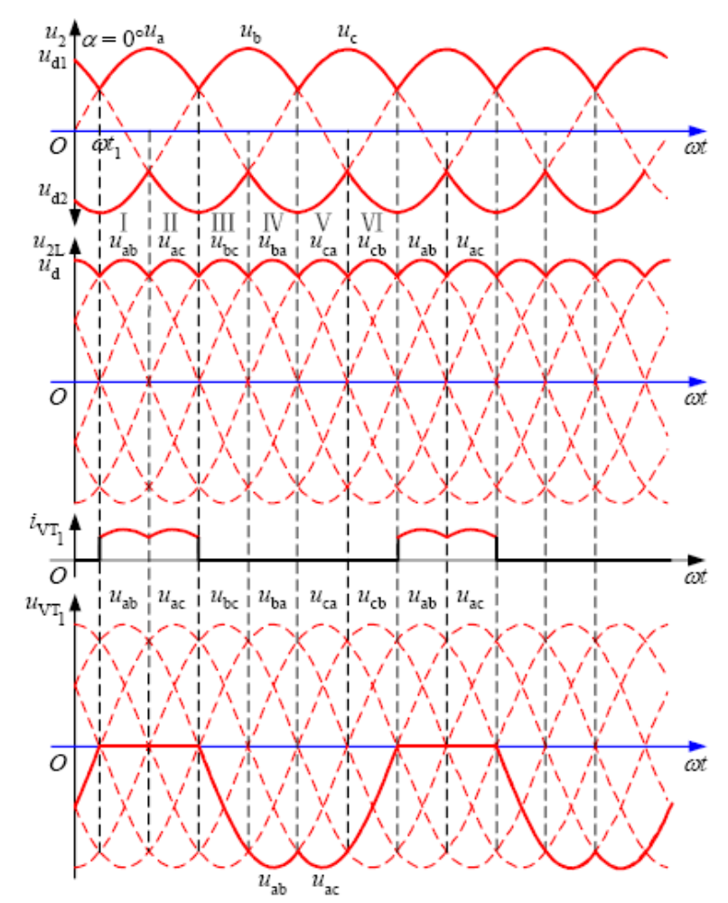
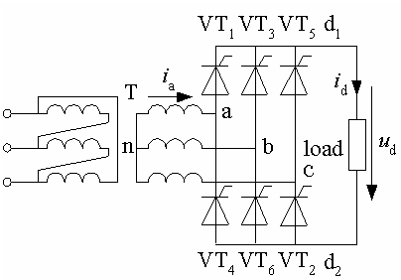
Three-phase bridge fully-controlled rectifier
Resistive load, α = 0º

Slide 26
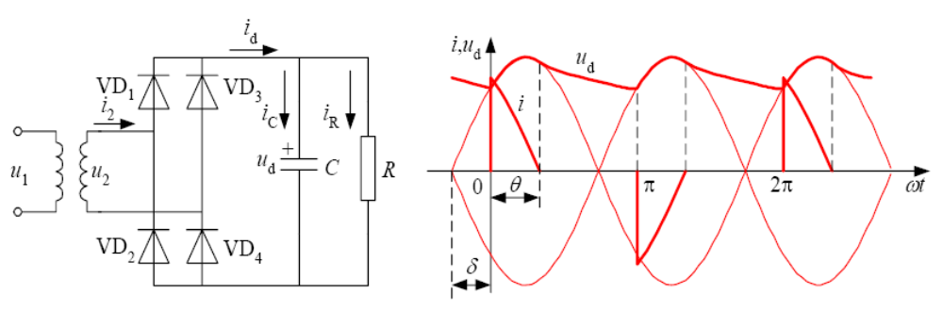
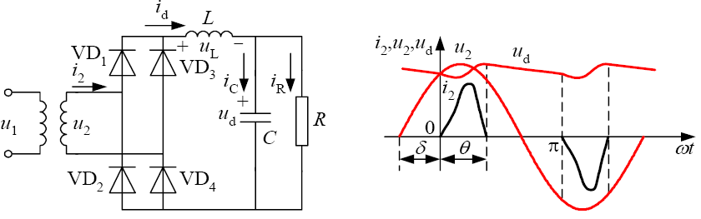
Capacitor-filtered single-phase uncontrolled rectifier

Slide 27
Harmonics and power factor of rectifier circuits
Originating of harmonics and power factor issues in rectifier circuits
  Harmonics: working in switching states, nonlinear
  Power factor: firing delay angle causes phase delay
Harmful effects of harmonics and low power factor
Standards to limit harmonics and power factor

Slide 28
Harmonics and power factor of rectifier circuits
Some conclusions that are easy to remember:
  – Only odd order harmonics exist in single-phase circuit, and only 6k±1 (k is positive integer) order harmonics exist in three-phase circuit.
  – Magnitude of harmonics decreases as harmonic order increases.
  – Harmonics increases and power factor decreases as capacitor increases.
  – Harmonics decreases and power factor increases as inductor increases.

Slide 29
3. DC to DC Converters (Choppers)
Outline
Basic DC to DC converters
  Buck converter (Step-down converter)
  Boost converter (Step-up converter)
  Buck-Boost converter (Step-down/step-up converter) and Cuk converter
  Sepic converter and Zeta converter
Composite DC/DC converters and connection of multiple DC/DC converters
  A current-reversible chopper
  Bridge chopper (H-bridge DC/DC converter)
  Multi-phase multi-channel DC/DC converters

Slide 30
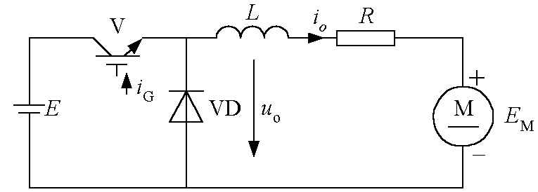
Buck Chopper
Typical utility: Driving a DC motor, or Charging a battery

Slide 31
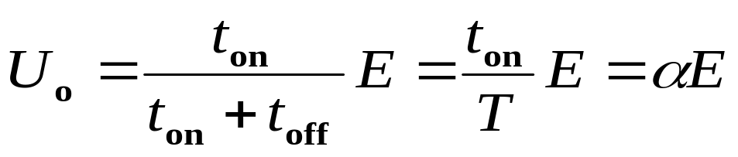
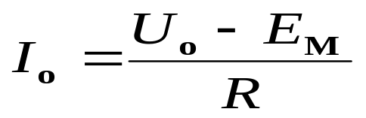
Buck Chopper
V
L
i
o
R
I₁
i
+
E
G
VD
u
o
M
E
-
M
Diagram
i
G
t
t
on
off
O
T
t
i
o
i
1
i
2
I
10
I
20
O
t
1
t
u
o
E
α : Duty Cycle
Current can be continuous or discontinuous
O
t
i
Continuous current
G
t
off
t
on
i
G
O
T
t
t
i
o
i
x
1
i
2
O
t
1
I
t
2
t
u
o
E
20
E
O
E
M
t
Discontinuous current

Slide 32
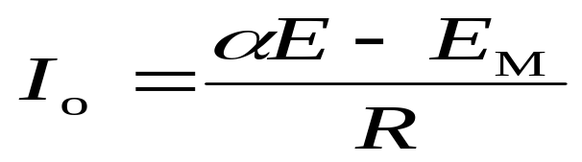
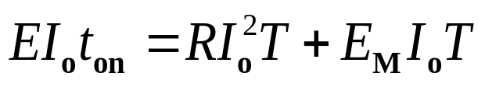
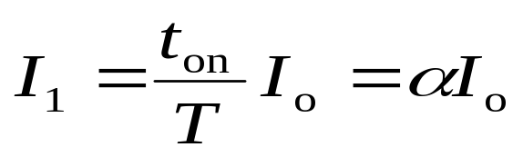
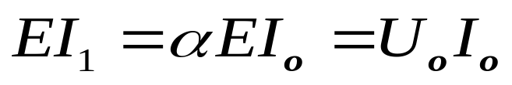
Buck Chopper
L→∞, Io → constant 不变
Input power = output power
“DC Transformer”

Slide 33
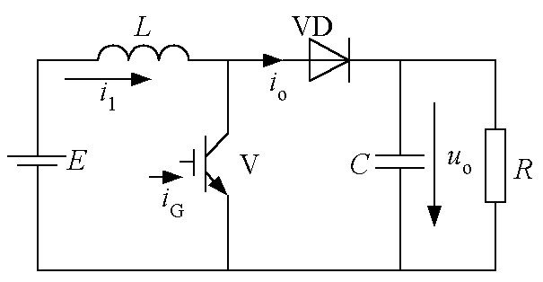
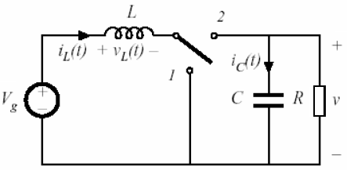
Boost Chopper
Energy container
Energy saving
Realization using power MOSFET and diode
Boost converter with ideal switch

Slide 34



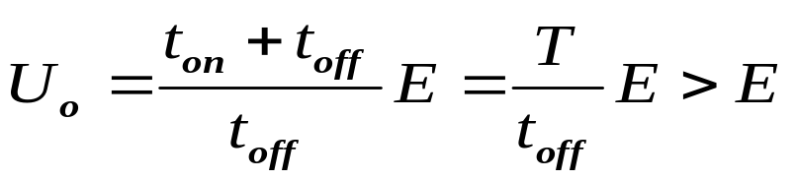
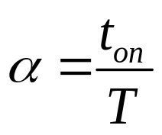
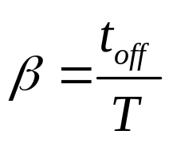

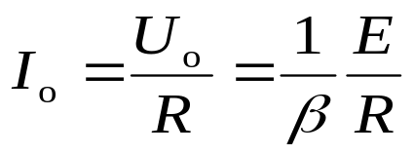
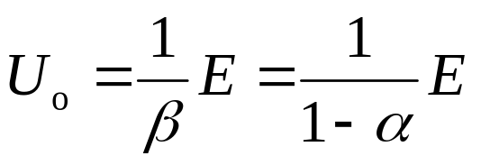
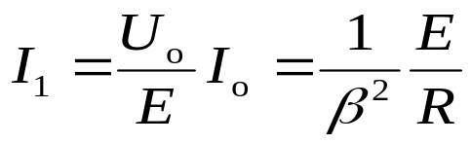
Boost Chopper
iG
  When V is on, energy saved in L is
  When V is off, energy released from L is
  When the circuit is stable,
0
t_{off} t_{on}
io
I1
0

Slide 35
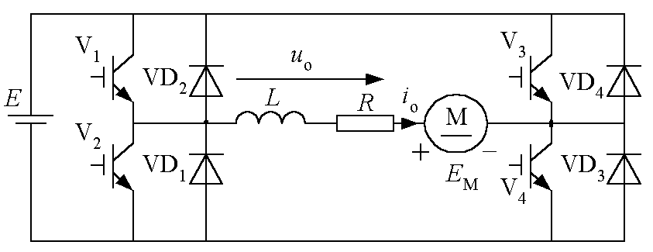
Bridge chopper (H-bridge chopper)
Can be considered as the combination of two current-reversible choppers.
Can realize 4-quadrant operation of DC motor.

Slide 36
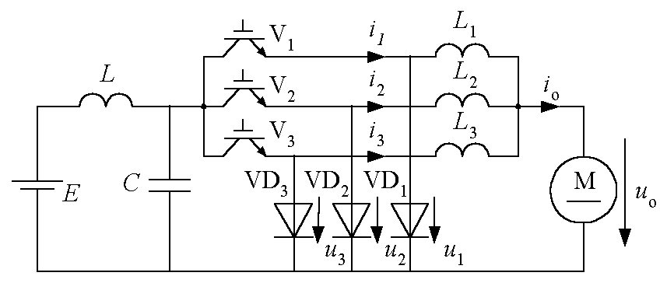
Multi-phase multi-channel DC/DC converter
Current output capability is increased due to multi-channel paralleling.
Ripple in the output voltage and current is reduced due to multichannel paralleling.
Ripple in the input current is reduced due to multi-phase paralleling.
1
u
O
t
2
u
O
t
3
u
O
t
o
i
O
t
1
i
O
t
2
O
t
i
3
O
t
i
o
O
t

Slide 37
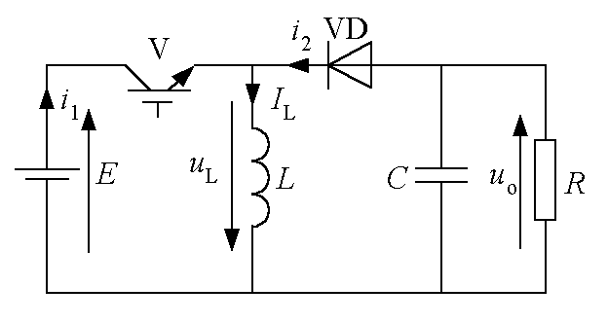



Other DC/DC converters
buck -boost Chopper
Cuk Chopper
Speic Chopper
Zeta Chopper

Slide 38
4. AC to AC Converters
Same frequency
variable magnitude
AC power
AC power
Variable
frequency
AC power
Frequency converters
(Cycloconverters)
AC controllers
AC to AC converters

Slide 39
Classification of AC controllers
AC controller
  Phase control: AC voltage controller (Delay angle control)
  Integral cycle control: AC power controller
  PWM control: AC chopper (Chopping control)
  On/off switch: electronic AC switch
PWM: Pulse Width Modulation

Slide 40
Classification of frequency converters
Frequency converter (Cycloconverter)
  Phase control: thyristor cycloconverter (Delay angle control)
  PWM control: matrix converter (Chopping control)
Cycloconverter is sometimes referred to
  in a broader sense—any ordinary AC to AC converter
  in a narrower sense—thyristor cycloconverter

Slide 41

AC voltage controllers
Single-phase AC voltage controller
Three-phase AC voltage controller
Applications
  Lighting control
  Soft-start of asynchronous motors
  Adjustable speed drive of asynchronous motors
  Reactive power control

Slide 42


Single-phase AC voltage controller
Resistive load
The phase shift range: 0 ≤ α ≤ π
RMS value of output voltage
RMS value of output current: I_{o} =U_{o}/R
Power factor of the circuit
u
1
O
ω
t
u
o
O
ω
t
i
o
O
ω
t
u
VT
O
ω
t

Slide 43

Single-phase AC voltage controller
Inductive (Inductor-resistor) load
The phase shift range:
ϕ ≤ α ≤ π
u₁ u
1
O
ω
t
u
0.6
u_{G1} G1
u
O
ω
t
G2
O
ω
t
u
o
O
ω
t
i
o
O
ω
t
u
VT
O
ω
t

Slide 44

Three-phase AC voltage controller
Y connection
Line-controlled Δ connection
Branch-controlled Δ connection
Neutral-point-controlled Δ connection

Slide 45




Thyristor cycloconverters
Another name: Thyristor AC to AC frequency converter, or direct frequency converter (as compared to AC-DC-AC frequency converter)
Can be classified into single-phase and three-phase according to the number of phases at output

Slide 46
5. DC to AC Converters (Inverters)
Applications of Inverters
Conversion of electric power from DC type energy sources to AC type load
  – Battery
  – Photovoltaic cell (Solar cell)
  – Fuel cell
As a part of composite converter
  – AC-DC-AC frequency converter (for AC motor drive)
  – AC-DC-AC constant-voltage constant-frequency converter (for uninterruptable power supplies)
  – AC-DC-AC Converters for induction heating
  – AC-DC-AC-DC switching power supplies

Slide 47
6. PWM Techniques
Pulse Width Modulation, the most widely used control technique in power electronics
Basic principles of PWM: equal-area theorem
This is sinusoidal PWM (SPWM)
The equal-area theorem can be applied to realize any shape of waveforms
u
SPWM wave
u
>
O
ωt
>
O
ωt
u
>
O
ωt

Slide 48


A sample of PWM
U
d
O
ω
t
-U
d
U
d
O
ω
t
-
U
d

Slide 49

AC-DC-AC converter

Slide 50
That’s all
Tanks for attention !

